Slide 1
EU COST CA 19130
Fintech and Artificial Intelligence in Finance Towards a transparent financial industry
Country Update - Switzerland
2023 and 2024

Slide 2
Core Members
Joerg Osterrieder - BFH Bern University of Applied Sciences - joerg.osterrieder@bfh.ch
Branka Hadji Misheva - BFH Bern University of Applied Sciences - heb1@bfh.ch
Christian Hopp - BFH Bern University of Applied Sciences - christian.hopp@bfh.ch
Lennart John Baals - BFH Bern University of Applied Sciences - lennart.baals@bfh.ch
Yiting Liu - Berner Fachhochschule - yil1@bfh.ch
Gabin TAIBI - BFH Bern University of Applied Sciences - gabin.taibi@bfh.ch
Lucía Gómez Teijeiro - BFH Bern University of Applied Sciences - lucia.gomezteijeiro@bfh.ch
Peter Schwendner - Zurich University of Applied Sciences - scwp@zhaw.ch
Marc Wildi - Zurich University of Applied Sciences - marc.wildi@zhaw.ch

Slide 3
Events
The 8th European COST Conference on Artificial Intelligence in Finance, Sep 29, 2023, Bern, Switzerland

Slide 4

Applications - Learning House

Slide 5
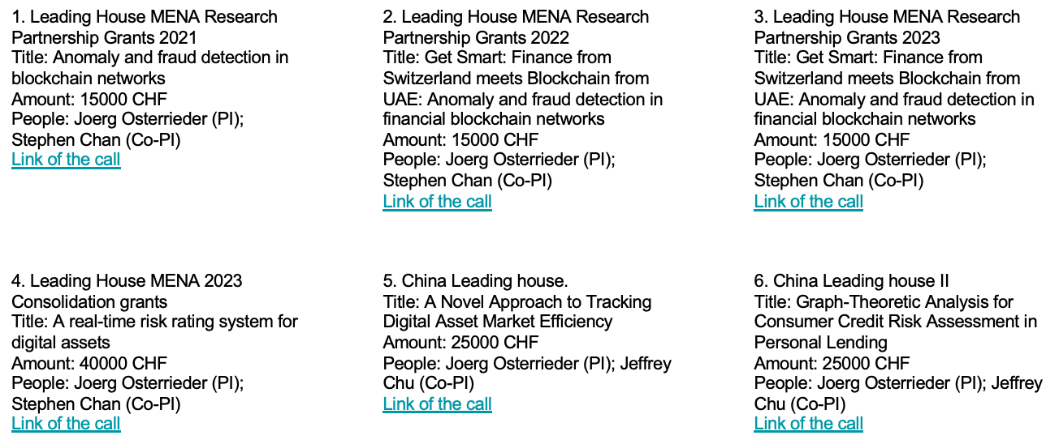
Applications - Leading House

Slide 6

Applications - MSCA DN Action
Banks & Fintechs
International Organisations
Faculties
Research Centers

Slide 7
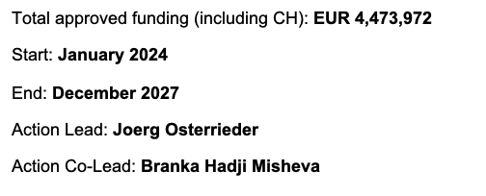
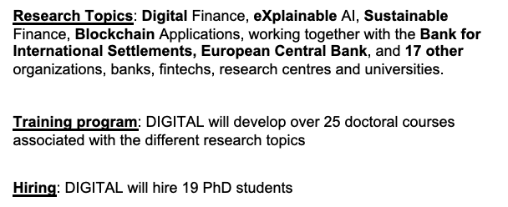
Applications - MSCA DN Action

Slide 8
Publications
Generative Adversarial Networks in finance: an overview; F. Eckerli, J. Osterrieder; doi.org/10.48550/arXiv.2106.06364
Audience-Dependent Explanations for AI-Based Risk Management Tools: A Survey; B. Hadji Misheva, D. Jaggi, J-A. Posth, T. Gramespacher, J. Osterrieder; doi.org/10.3389/frai.2021.794996
The Efficient Market Hypothesis for Bitcoin in the context of neural networks; M. Kraehenbuehl, J. Osterrieder; doi.org/10.48550/arXiv.2208.07254
AI for trading strategies; D. Jevtic, R. Deleze, J. Osterrieder; doi.org/10.48550/arXiv.2208.07168
High-Frequency Causality in the VIX Index and its derivatives: Empirical Evidence; K. Farokhnia, J. Osterrieder; doi.org/10.48550/arXiv.2206.13138
Editorial: Artificial intelligence in finance and industry: Highlights from 6 European COST conferences; A. Henrici, J. Osterrieder; doi.org/10.3389/frai.2022.1007074

Slide 9
Publications
Discussion on: “Programmable money: next generation blockchain based conditional payments” by Ingo Weber and Mark Staples; J. Osterrieder; doi.org/10.1007/s42521-022-00063-9
Simulating financial time series using attention; W. Fu, A. Hirsa, J. Osterrieder; doi.org/10.48550/arXiv.2207.00493
Applications of Reinforcement Learning in Finance -- Trading with a Double Deep Q-Network; F. Zejnullahu, M. Moser, J. Osterrieder; doi.org/10.48550/arXiv.2206.14267
A Primer on Narrative Finance; J. Osterrieder; dx.doi.org/10.2139/ssrn.4324860
Digital Finance: Reaching New Frontiers; J. Osterrieder, B. Hadji Misheva, M. Machado; doi.org/10.12688/openreseurope.15386.1

Slide 10
Publications
The Great Deception: A Comprehensive Study of Execution Strategies in Corporate Share Buy-Backs; M. Seigne, J. Osterrieder; https://doi.org/10.48550/arXiv.2307.09617
Navigating the Environmental, Social, and Governance (ESG) landscape: constructing a robust and reliable scoring engine - insights into Data Source Selection, Indicator Determination, Weighting and Aggregation Techniques, and Validation Processes for Comprehensive ESG Scoring Systems; Y. Liu, J. Osterrieder, B. Hadji Misheva, N. Koenigstein, L. Baals; doi.org/10.12688/openreseurope.16278.1
Unraveling market mysteries: a comprehensive review of financial anomalies and puzzles; J. Osterrieder, M. Seigne; doi.org/10.12688/openreseurope.16436.1

Slide 11
Publications
Share buybacks: a theoretical exploration of genetic algorithms and mathematical optionality; J. Osterrieder; doi.org/10.3389/frai.2023.1276804
Modelling taxpayers’ behaviour based on prediction of trust using sentiment analysis; I-F. Coita, S. Belbe, C. Mare, J. Osterrieder, C. Hopp; doi.org/10.1016/j.frl.2023.104549
Examining share repurchase executions: insights and synthesis from the existing literature; J. Osterrieder, M. Seigne; doi.org/10.3389/fams.2023.1265254
Leveraging network topology for credit risk assessment in P2P lending: A comparative study under the lens of machine learning; Y. Liu, L. Baals, J. Osterrieder, B. Hadji-Misheva; doi.org/10.1016/j.eswa.2024.124100
Examining Share Repurchase Executions: Insights and Synthesis from the Existing Literature; J. Osterrieder; dx.doi.org/10.2139/ssrn.4548038

Slide 12
Publications
Towards a new PhD Curriculum for Digital Finance; L. Baals, J. Osterrieder, B. Hadji-Misheva, Y. Liu; doi.org/10.12688/openreseurope.16513.1
Hypothesizing Multimodal Influence: Assessing the Impact of Textual and Non-Textual Data on Financial Instrument Pricing Using NLP and Generative AI; K. Bolesta, G. Taibi, C. Mare, B. Hadji Misheva, C. Hopp, J. Osterrieder; dx.doi.org/10.2139/ssrn.4698153
Network centrality and credit risk: A comprehensive analysis of peer-to-peer lending dynamics; L. Baals, J. Osterrieder, B. Hadji-Misheva, Y. Liu; doi.org/10.1016/j.frl.2024.105308
Wasserstein GAN: Deep Generation applied on Bitcoins financial time series; S. Rikli, D. N. Bigler, M. Pfenninger, J. Osterrieder; doi.org/10.48550/arXiv.2107.06008

